Slide 1





Making the world green one BIOplastic at a time
LPU - Laguna Christine Quimio, CBA

Slide 2

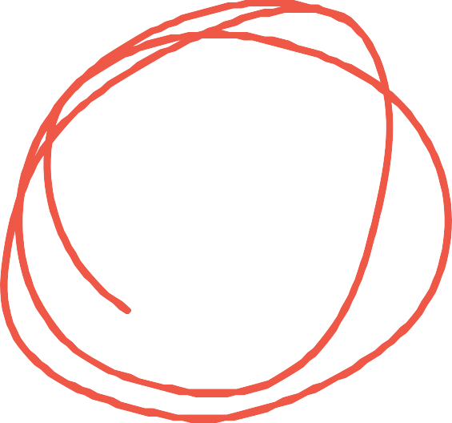
Over
Problem #1
256M
plastic items get thrown out on a daily basis.
(Gaia, 2019)

Slide 3
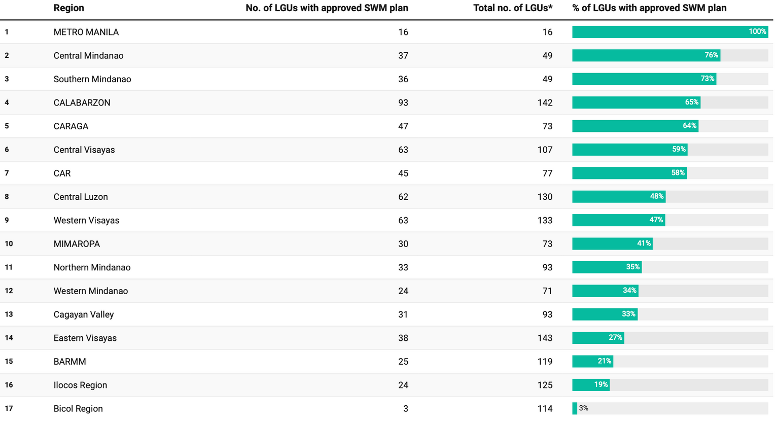
Approved 10-year solid waste management plan
* Based on the Philippine Standard Geographic Code, as of March 2019 Source: National Solid Waste Management Commission

Slide 4

About
Problem #2
2M
people in BARMM are considered poor.
(Dy, 2019)

Slide 5
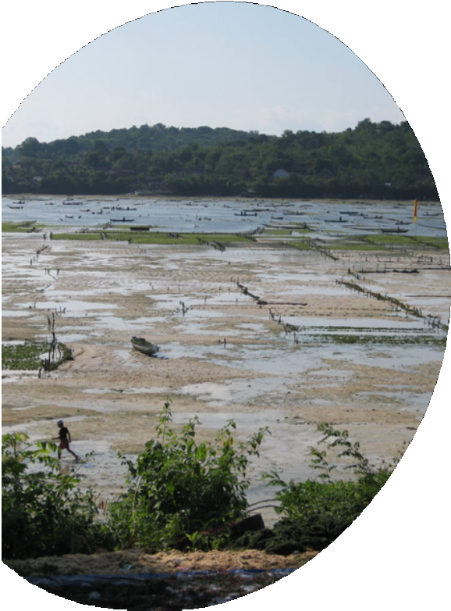
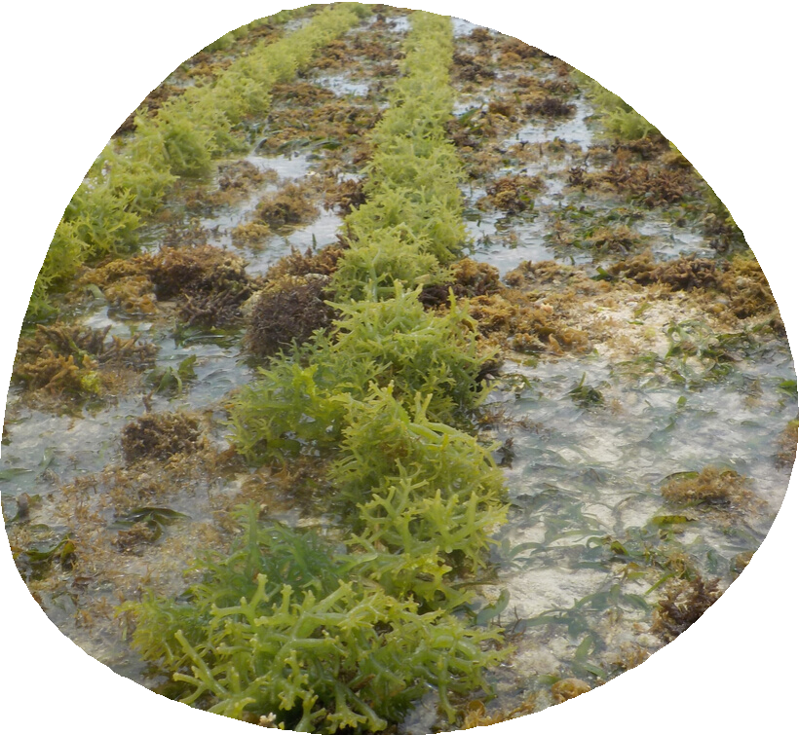
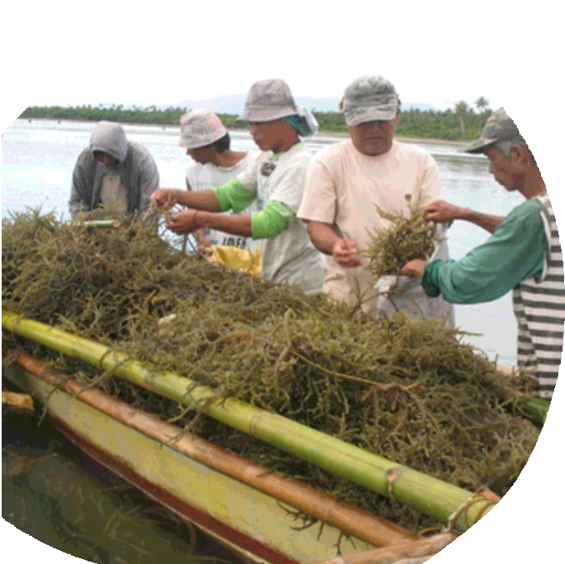
BARMM captures
However,
63.8%
of the total aquaculture
production in the country.
(PSA, 2019)

Slide 6
49.5% share
Tawi-Tawi has the highest concentration of aquaculture production in the region.
(PSA, 2019)

Slide 7
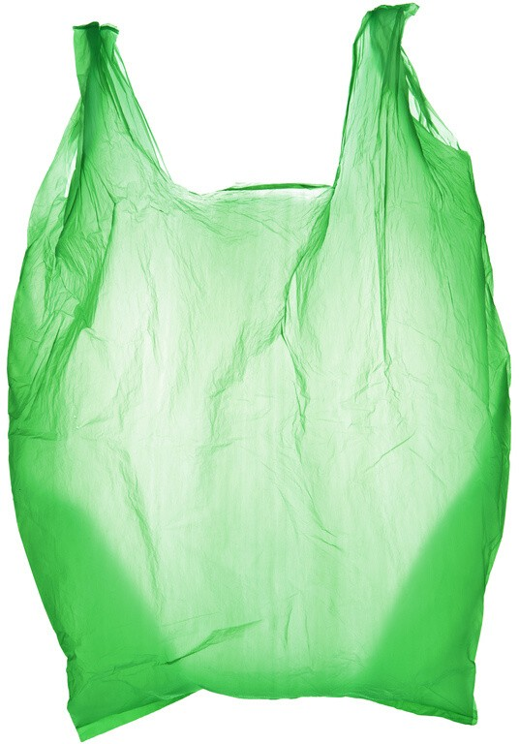




Solution
Eco- friendly
Safe
Non-toxic
Seaweed Bioplastics
Low Maintenance
Affordable

Slide 8
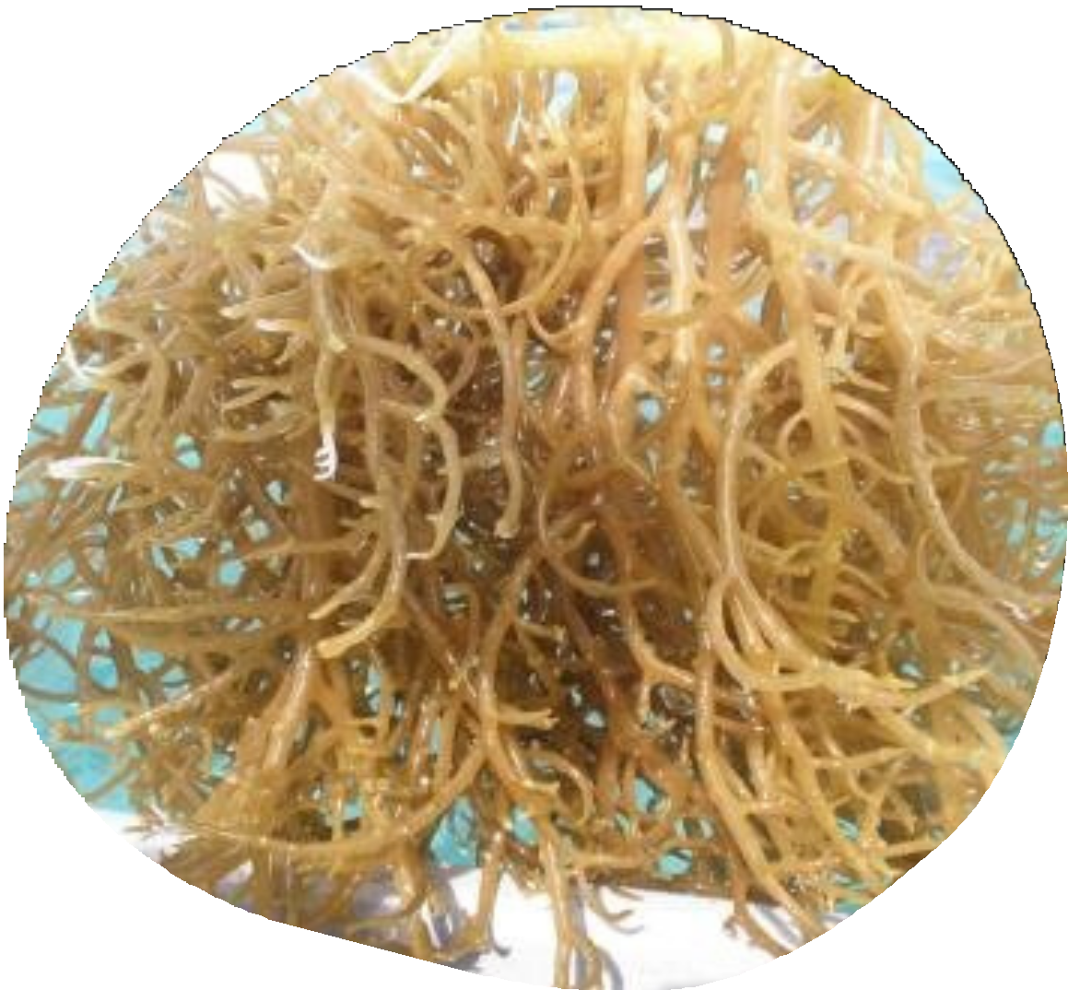
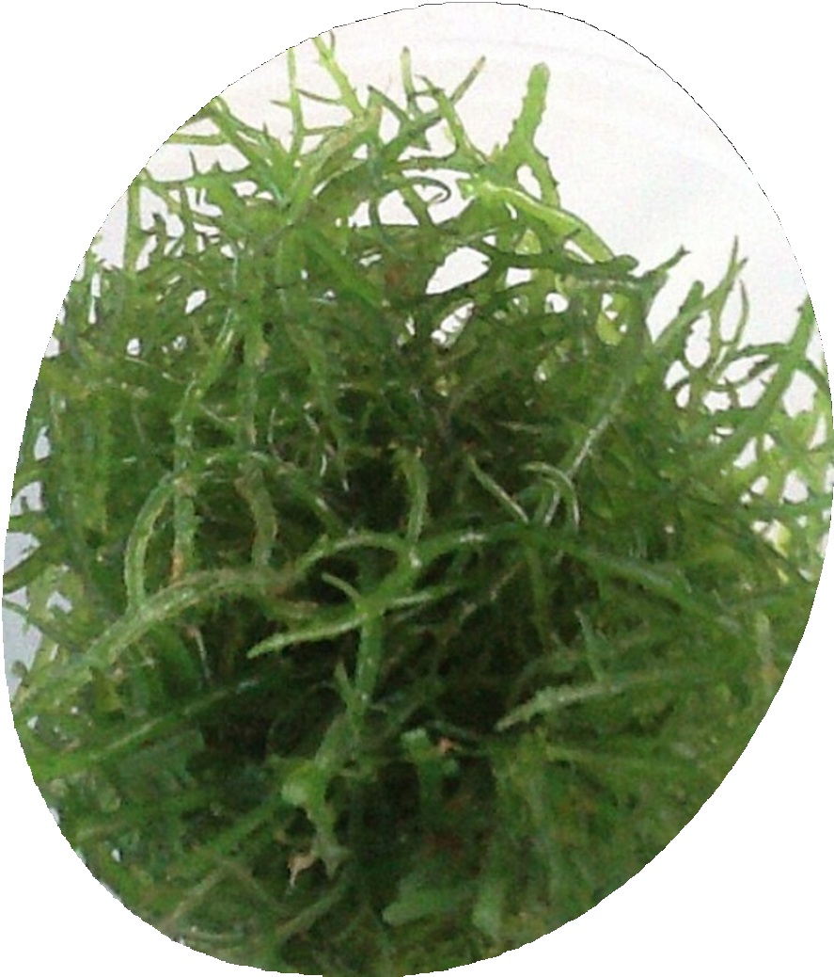

Components:
Water
Corn starch
Tambalang
/ Guso
As provided by the Professionals group at Omar bin AbdulAziz Secondary Independent School
Collagen

Slide 9
Possibilities

Slide 10




How is it different from the others?
The bioplastic dissolves in water and it can be a sustainable s ource of income for the people.
(RFI, 2019)

Slide 11



Business Opportunity
Long background with Seaweed Farming
Create local job opportunities
Potential to expand economic growth

Slide 12
Timing
Market Size Potential Growth
The global biodegradable plastics market size is projected to reach USD 6.73 billion by 2025
(Research and Markets, 2018)
Plastic Bag Ban in BARMM offices
By the use of seaweed bioplastics, businesses will still be able to provide convenient and cheap packaging to customers that will not let businesses disobey the law.
(Policar, 2019)

Slide 13

Conclusion
Seaweeds are a viable source for creating bioplastics
It will help reduce risk of plastic crisis globally
It will raise the economic activity of BARMM

Slide 14

Get In Touch With Us
Company Address
KM. 54 National Hi-way, Makiling, Calamba City, Laguna
Phone Number
09224184705
Website
lpulaguna.edu.ph

